Slide 1
American dance
Four artists define a nation

Slide 2
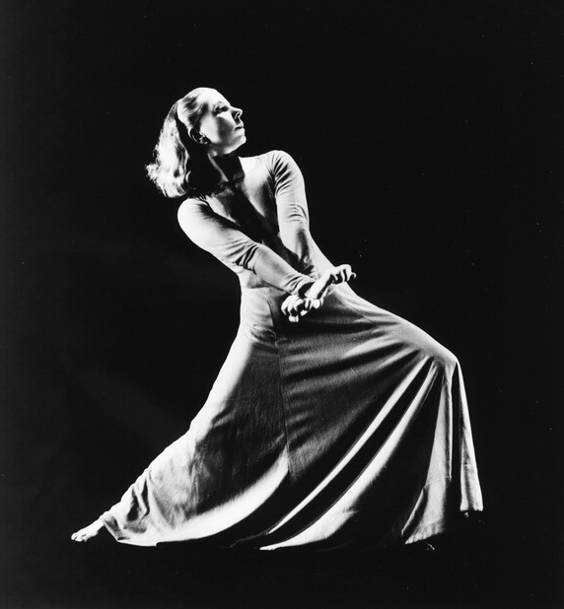
The premise of “art” in the modern age
Artists in the 1950s called their work “modern.” Today, “modern” still refers to art of the early and mid-20th century. ”Modern” does not refer to work of today.
Modern artists believed that there was a direct communication of art to audience, that with sufficient skill, technique, and craftsmanship, they could communicate their ideas. Today, many artists reject that idea, and believe that what the audience “gets” has as much to do with the individual viewer as with the individual artist. This is an attribute of “post-modern” art, which began to take hold in the 1960s.
Modern dance artists (in a variety of styles) generally had a very clear meaning that they intended to express in their works, and crafted the look of the dancing to express that meaning.

Slide 3
One theme of the modern age… “AMERICAN” DANCE
Choreographers asked…
We ask…
What is “American Dance”?
Who or what is “American”?
Does this dance exist, or must we invent it?
Why was this important to artists?
What answers did they come up with?
How did they express their ideas for audiences?
How did their answers change over time?

Slide 4
Martha Graham: American heroism
"A dance reveals the spirit of the country in which it takes root...To the audience of America, the American dance owes a duty. It must not lull them into complacency by presenting a decorative or imitative dance form as a product of this county...We look to the dance for affirmation, to make the spectator more keenly aware of the vigor, the humor, and the variety of life.”
- Martha Graham from “Platform for the American Dance”
By the 1950s, Martha Graham was an American icon. Her early work explicitly represented a heroic model of American “types,” with particular stress on Puritans and pioneers.
“Frontier” (1938)
“American Document” (1938)
“Appalachian Spring” (1944)
Frontier, 1938

Slide 5
Katherine Dunham: American shame
”North America is a great and wonderful country… The people of North America are great and wonderful too, in their newness and youth and energy. But there is a deep stain, a mark of blood and shame which spreads from under the magnolia trees of the southland area and mingles with the perfume of the flowers”
- Prologue, Southland (1951)
Dunham was an anthropologist, dancer, and choreographer who studied Haitian dance and brought Caribbean styles to the Broadway stage.
However, her most explosive work, Southland, was never staged in the US. Southland targeted lynching, and it was deemed too controversial for US audiences. It premiered in Santiago, Chili.
The American embassy disapproved, and Dunham believed that she was denied the support of the US government for foreign tours from that point onward.

Slide 6
George Balanchine: American rhythm
“The difference … is a timing difference, an energy difference. It was never meant to be lyrical. One difference was that many of the steps were very off-center... The energy behind the steps was different. They were attacked more...”
- a Balanchine ballerina describing Barocco
Balanchine immigrated to the United States in the 1920s. After several attempts to start schools and companies, he found a permanent platform for his work in the 1940s with the New York City Ballet. His style became known as “neo-classical,” but it contains rhythmic and dynamic qualities associated with jazz.
Balanchine was fascinated by the “coolness and speed” of Americans, and believed that he could capture those attributes and make a new American ballet during the 1950s and 1960s.
Agon, 1957

Slide 7
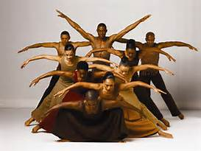
Alvin Ailey: American promise
“I am trying to show the world that we are all human beings and that color is not important. What is important is the quality of our work.”
“Racism tears down your insides so that no matter what you achieve, you’re not quite up to snuff.”
Alvin Ailey created an all-black dance company in New York in 1958. The same year, he created his masterpiece Revelations, a suite of dances set to “Negro spirituals” which explored the struggle and community he experienced as a child.
Revelations was not explicitly political, and thus was accepted by white audiences and promoted by the US government as an export on tour to the Soviet Union.
Today, it can be hard to see the “edge” in Ailey’s work. However, for black audiences in the 50s and 60s, his work offered them entrée into the larger American story.
Revelations, 1958

